Slide 1
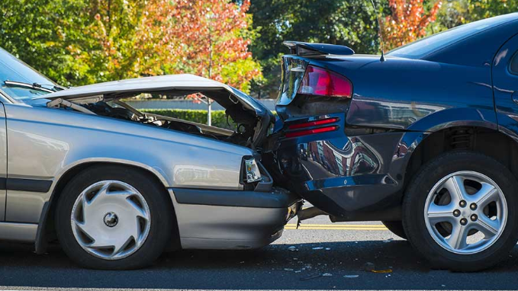
An analysis of Victorian road accidents 26 September 2019
Prepared by: Gorfrind

Slide 2
Executive summary
Scope of the analysis
This analysis has been done of the data provided by PwC. The aim of the analysis is to ascertain the key indicators and trends in accidents within Victoria.
The analysis shows that there are prominent causal factors for the majority of accidents and severity arising from accidents.
This report has also sought to consider possible strategies to reduce accidents taking into account the causal factors.
Obviously, additional significant work needs to be undertaken to determine the practicality and cost to implement any of the suggested solutions.
Such cost analysis is beyond the scope of this report.
Key findings
The analysis suggests that speeding is likely to be the leading cause of accidents in Victoria. This conclusion is based on the following findings, viz most accidents:
are rear end collisions
happen in urban/built up areas
occur in 50km/h and 60km/h zones
on straight roads (i.e. no intersection)
As such the strategies proposed in this report to reduce accidents are focused on preventing speeding

Slide 3

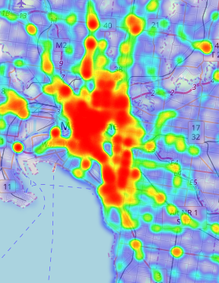
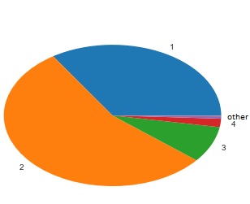
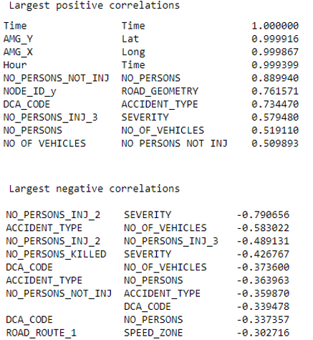
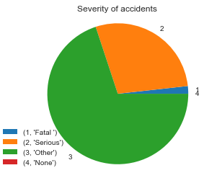
Broad data analysis
Number of vehicles involved in accidents
Key observations
Approximately 70% of accidents have happened in Melbourne – mostly within the metropolitan region
Most accidents involve two vehicles
No unexpected correlations from table
Most accidents are not fatal
CBD

Slide 4
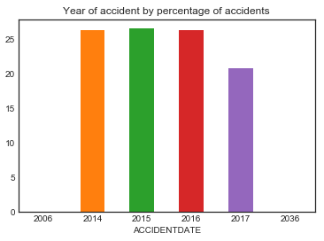
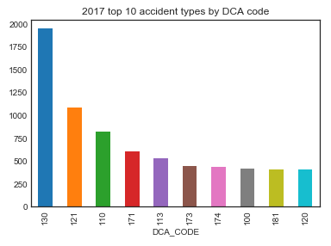
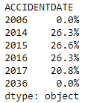
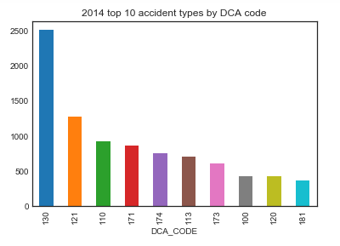
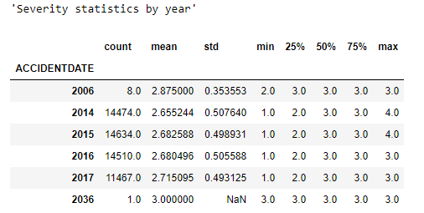
Analysis of time
Key observations
Decrease in accidents between 2016 and 2017
No material changes in spread (of accident types or severity) from first and last year
The year for 2036 and 2006 is likely 2016, entry thus was left unchanged due to minimal affect The year 2006 does not start at the beginning

Slide 5
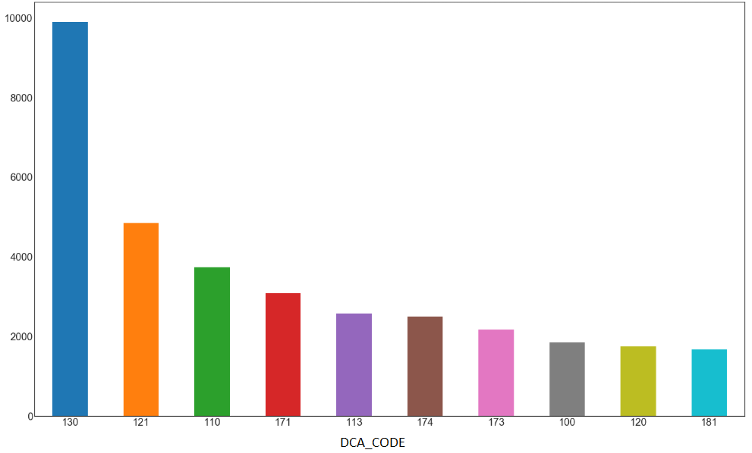
Most common types of accidents
130 | 9899 | Rear end (vehicles in same lane)
121 | 4851 | Right through
110 | 3733 | Cross traffic (intersections only)
171 | 3092 | Left off carriageway into object/parked vehicle
113 | 2577 | Right near (intersections only)
174 | 2500 | Out of control on carriageway (on straight)
173 | 2177 | Right off carriageway into object/parked vehicle
100 | 1847 | Pedestrian near side hit by vehicle from the right
120 | 1745 | Head on (not overtaking)
181 | 1670 | Off right bend into object/parked vehicle
Key observations
10 most common account for ~62% of all accidents in Victoria
Rear end collision’s make up ~18% of all accidents in Victoria
The next most common accident – right through – is ~8%, half that of rear end collisions.

Slide 6
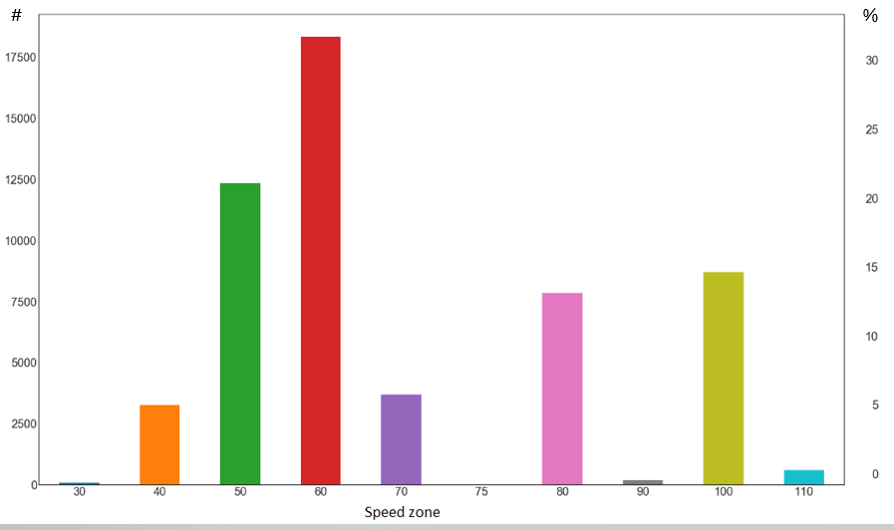
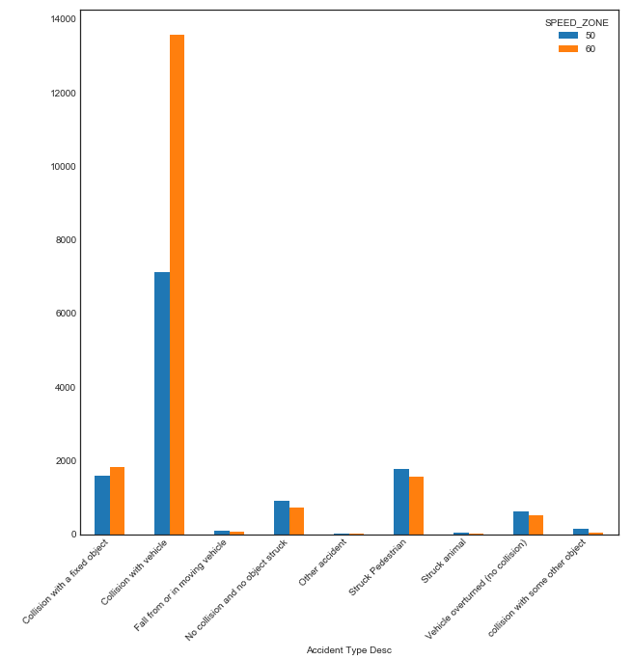
Speed
Other speed 70 cases and thus was removed
Camping/off-road given value of 100 (average country road speed)
Unknowns given value of 50 (average speed in city) – as most accidents were in CBD
Key observations
The above graph shows ~56% of accidents occur in 50km/h and 60km/h zones; this suggests that the majority of accidents occur in built up/urban areas
The graph on the right suggests people are unable to stop in time resulting in an accident – as rear end collisions are the most common form of accident

Slide 7
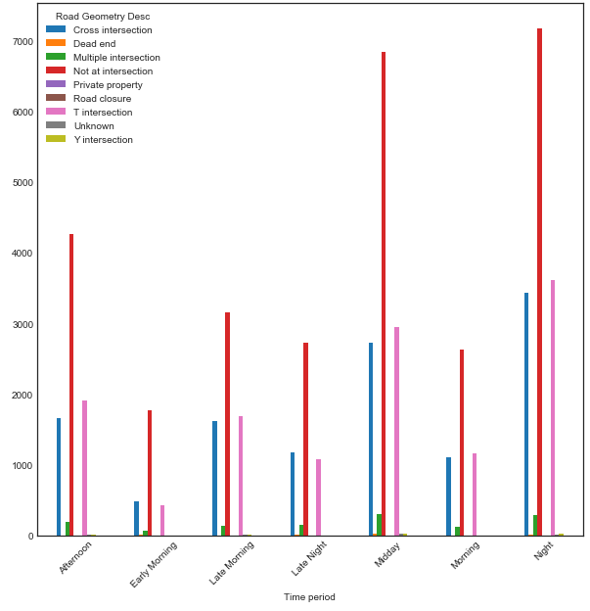
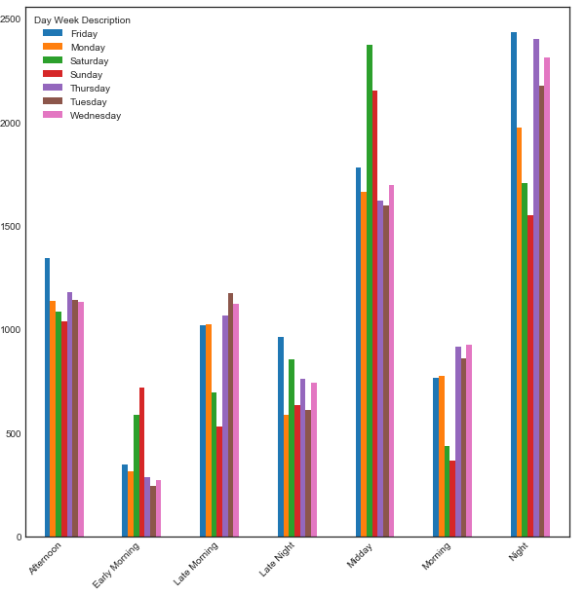
Road geometry and time that accidents occur
Time and day that accidents occur
Key observations
The graph on the left shows that most accidents do not occur at intersections – implies cars are not stopping in time
The graph on the right shows that accidents are more likely to occur at midday and at night (day of week has minimal effect);
The increase in accidents at night could due to people driving unsafely to rush home from work
Lunch hour could be contributing to the increase in accidents during midday time period

Slide 8
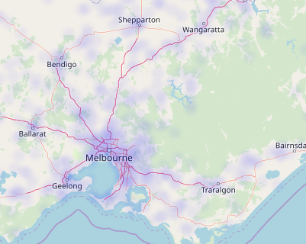
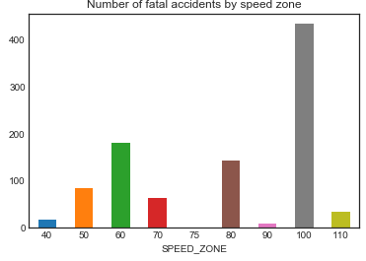
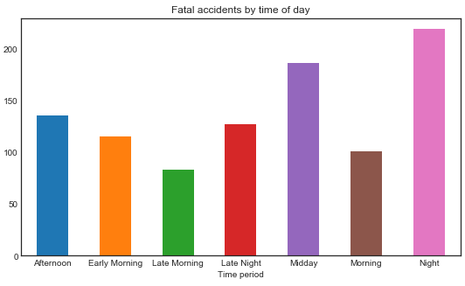
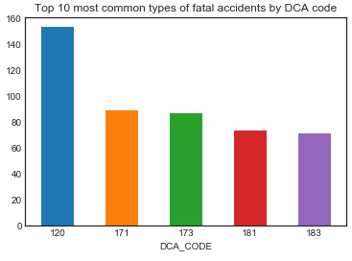
Fatal accidents
Key observations
Fatal accidents are far less common
Fatal accidents happen with highest concentration in Melbourne though far more spread out
Fatal accidents occur mostly in 100km/h zones
Fatal accidents are usually head on collisions (DCA code 120)

Slide 9
Findings and recommendations
Summary of findings | Suggested solutions
More accidents at certain times of day | Variable speed limits and cameras based on time of day – such as school zones Reorganizing police patrol shifts
Most accidents are rear end – implies drivers are not stopping in time | Increase the number of speed camera’s Possible speed bump placements
Heat map shows clear concentration of accidents in certain areas – most accidents occur in metropolitan Melbourne | Reallocate traffic and road resources from regional areas to Melbourne metropolitan area Reorganise police patrols on to focus on accident prone areas
Accidents occur most on a straight road (i.e. not at an intersection) – implies speeding or lack of attention | Change road geography (i.e. add roundabouts) Increase number of traffic lights
Accidents most likely to occur in 50km/h and 60km/h speed zones – implies speeding | Advertising campaign to increase awareness of dangers of speeding in built up areas Increase speeding fines
Fatal accidents are mostly head on collisions | Install road dividers in dangerous areas

Slide 10
Conclusion
Summary of analysis
From data analysis Rear end collisions are by far the most common form of accident thus lowering the chance of accidents of theses types would lower accidents by the largest amount. Based on the data it can be concluded that accident rate affects by numerous features, the largest factors are:
Location
Road geometry
Light conditions
Speed zone
Time of day
Generally car accidents are not fatal, however these are the more important accidents to prevent. These happen in 100km/h zones and occur from head on collisions. From the heatmap it is obvious where accident reduction measures should be implemented.
Limitations of analysis The data set did not contain other key information that would provide a more clear understanding of accident incidences. The data is over a period of four years (between 2014 and 2018). As such it is impossible to know what measures were implemented during that period. A more sufficient analysis would have an expanded data set to include information such as:
Age of driver
Age of car
Sex of driver
Car make
Weather conditions
Additionally, the data does not include information regarding the most common causes of accidents, such as:
Involvement of drugs or alcohol
Mobile phone usage
Speeding

